Slide 1
Biological Modeling of Neural Networks:
Week 15 – Integral Equation for population dynamics
15.1 Populations of Neurons
- review: homogeneous population
- review: parameters of single neurons
15.2 Integral equation
- aim: population activity
- renewal assumption
15.3 Populations with Adaptation
- Quasi-renewal theory
15.4. Coupled populations
- self-coupling
- coupling to other populations
Week 15 – Population Dynamics:
The Integral –Equation Approach
Wulfram Gerstner
EPFL, Lausanne, Switzerland

Slide 2
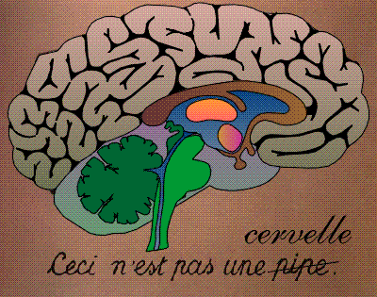
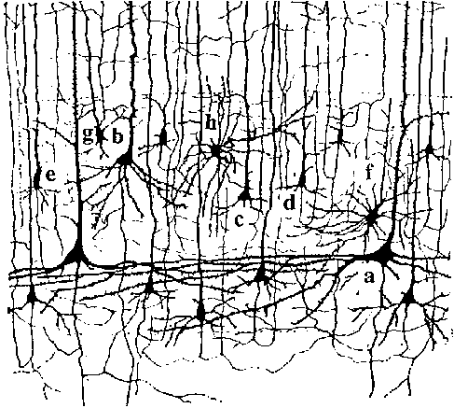
Neuronal Dynamics – Brain dynamics is complex
Week 15-part 1: Review: The brain is complex
10 000 neurons
3 km of wire
motor
cortex
1mm
frontal
cortex
to motor
output

Slide 3
Week 15-part 1: Review: Homogeneous Population
Example: 2 populations
excitation
Homogeneous population:
each neuron receives input
from k neurons in the population
-each neuron receives the same
(mean) external input (could come from
other populations)
each neuron in the population has roughly
the same parameters
inhibition

Slide 4
Week 15-part 1: Review: microscopic vs. macroscopic
I(t)
microscopic:
spikes are generated
by individual neurons
spikes are transmitted
from neuron to neuron
macroscopic:
Population activity An(t)
Populations interact via
An(t)

Slide 5
Week 15-part 1: Review: coupled populations
I(t)

Slide 6

Week 15-part 1: Example: coupled populations in barrel cortex
Neuronal Populations
= a homogeneous group of neurons
(more or less)
Populations:
- pyramidal neurons in layer 5 of barrel D1
- pyramidal neurons in layer 2/3 of barrel D1
- inhibitory neurons in layer 2/3 of barrel D1
100-2000 neurons
per group (Lefort et al., NEURON, 2009)
different barrels and layers, different neuron types → different populations

Slide 7
Week 15-part 1: Global aim and strategy
Extract parameters for SINGLE neuron
(see NEURONAL DYNAMICS, Chs. 8-11; review now)
Dynamics in one (homogeneous) population
Today, parts 15.2 and 15.3!
-Dynamics in coupled populations
Understand Coding in populations
-Understand Brain dynamics
Sensory input

Slide 8
Week 15-part 1: Review: Spike Response Mode (SRM)
Spike emission
i
Input
I(t)
3 arbitrary
linear filters
potential
threshold

Slide 9
SRM +escape noise = Generalized Linear Model (GLM)
j
i
spike
-spikes are events
-spike leads to reset/adapt. currents/increased threshold
-strict threshold replaced by escape noise:
exp
Jolivet et al., J. Comput. NS, 2006

Slide 10
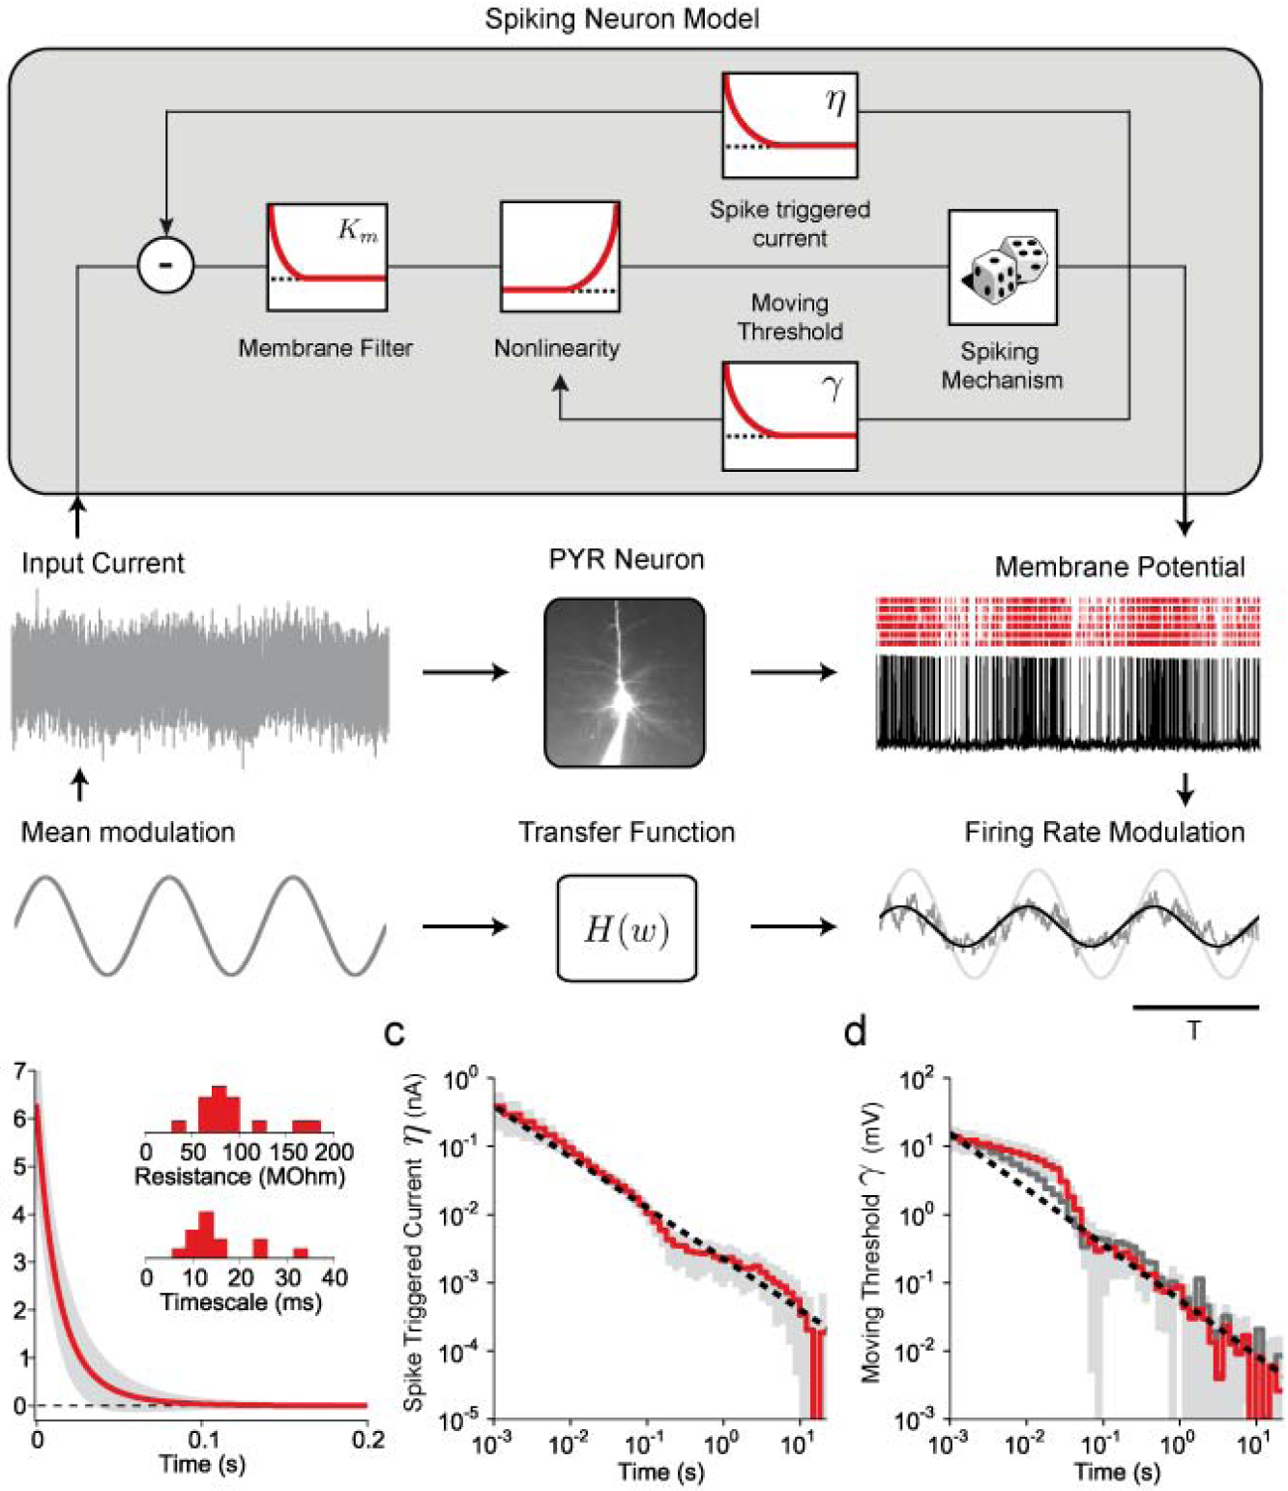
current
threshold
Input current:
Slow modulation
-Fast signal
Adaptation
- extends over several seconds
- power law
current
threshold
Pozzorini et al.
Nat. Neuros,
2013

Slide 11
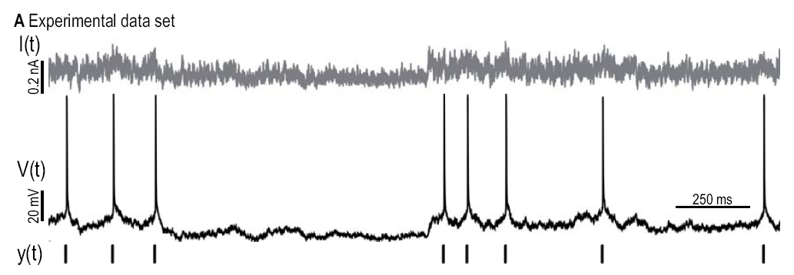
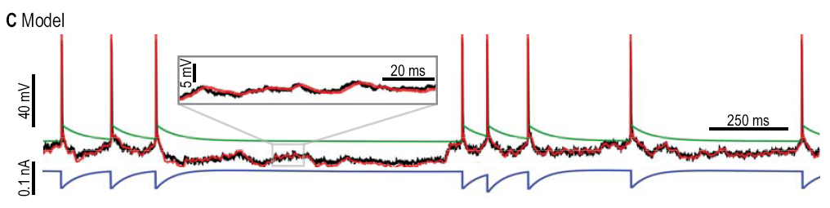
Week 15-part 1: Predict spike times + voltage with SRM/GLM
Dyn. threshold
Mensi et al. 2012,
Jolivet et al. 2007
Adaptation current

Slide 12
Week 15-part 1: Extract parameter for different neuron types
current
Mensi et al.
2011
threshold
Dynamic threshold
Fast Spiking
Non-fast Spiking
Pyramidal N.
Dyn. Threshold
VERY IMPORTANT
Dyn. Threshold
important
Dyn. Threshold
unimportant
current
Different neuron types have different parameters

Slide 13
Week 15-part 1: Summary and aims
We can extract parameters for SINGLE neuron
(see NEURONAL DYNAMICS, Chs. 8-11)
Different neuron types have different parameters
→ Model Dynamics in one (homogeneous) population
Today, parts 15.2 and 15.3!
→ Couple different populations
Today, parts 15.4!
Sensory input
Eventually: Understand Coding and Brain dynamics

Slide 14
Biological Modeling of Neural Networks:
Week 15 – Integral Equation for population dynamics
15.1 Populations of Neurons
- review: homogeneous population
- review: parameters of single neurons
15.2 Integral equation
- aim: population activity
- renewal assumption
15.3 Populations with Adaptation
- Quasi-renewal theory
15.4. Coupled populations
- self-coupling
- coupling to other populations
Week 15 – Population Dynamics:
The Integral –Equation Approach
Wulfram Gerstner
EPFL, Lausanne, Switzerland

Slide 15

Week 15-part 2: Aim: from single neuron to population
Single neurons
- model exists
- parameters extracted from data
- works well for step current
- works well for time-dep. current
I(t)
Population of Neurons?
Population equation for A(t)
-existing models
- integral equation

Slide 16
Week 15-part 2: population equation for A(t) ?
t
I(t)
?
Question: – what is correct?
h(t)
potential
population
activity
Wilson-Cowan
A(t)
Ostojic-Brunel
Paninski, Pillow
A(t)
LNP
A(t)
current
Poll!!!
Benda-Herz
A(t)

Slide 17
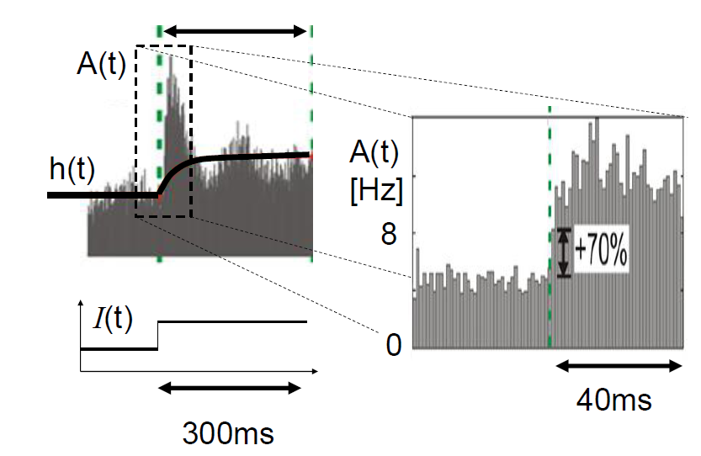
Week 15-part 2: A(t) in experiments: step current, (in vitro)
Experimental data: Tchumatchenko et al. 2011
See also: Poliakov et al. 1997

Slide 18
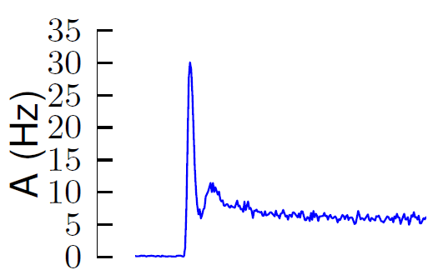
Week 15-part 2: A(t) in simulations : step current
25000 identical model neurons (GLM/SRM with escape noise)
parameters extracted from experimental data
response to step current
simulation data:
Naud and Gerstner, 2012
I(t)
h(t)
potential

Slide 19
Week 15-part 2: A(t) in theory: an equation?
Can we write down an equation for A(t) ?
Simplification: Renewal assumption
Potential (SRM/GLM) of one neuron
h(t)
Sum over all past spikes
Keep only last spike
→ time-dependent renewal theory

Slide 20
Week 15-part 2: Renewal theory (time dependent)
Keep only last spike → time-dependent renewal theory
Potential (SRM/GLM) of one neuron
last spike

Slide 21
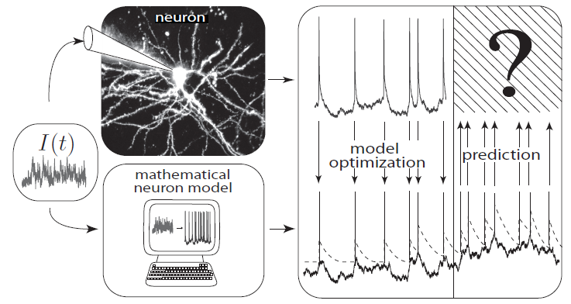
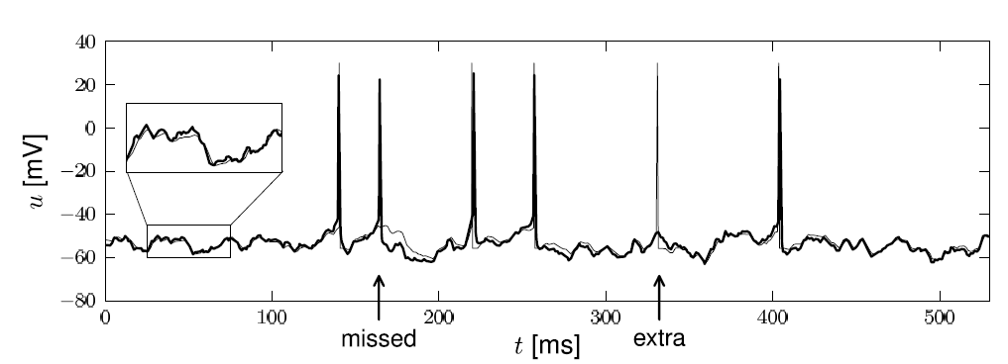
Week 15-part 2: Renewal model –Example
t
deterministic part of input
noisy part of input/intrinsic noise
→ escape rate
Example:
nonlinear integrate-and-fire model
Example:
exponential stochastic intensity

Slide 22
Week 15-part 2: Renewal model - Interspike Intervals
escape process
Survivor function
A
u(t)
t
escape rate
Interval distribution
escape
rate
Survivor function
u

Slide 23
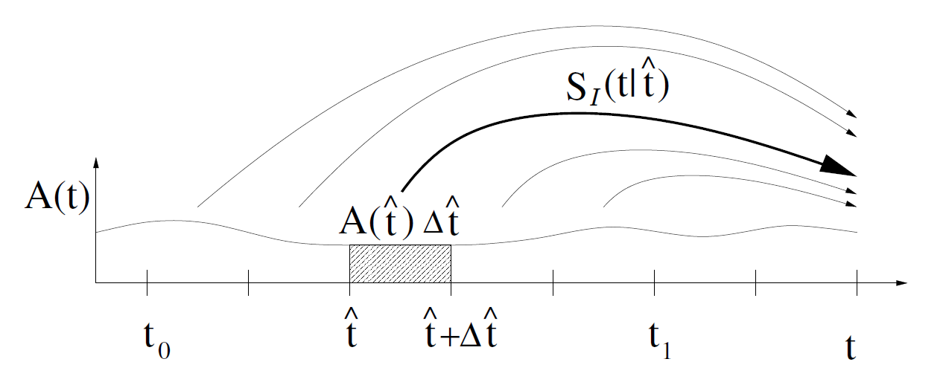
Week 15-part 2: Renewal model – Integral equation
population activity
Image:
Gerstner et al.,
Neuronal Dynamics, Cambridge Univ. Press (2014)
Blackboard!
Interval distribution
escape
rate
Survivor function
Gerstner 1995, 2000; Gerstner&Kistler 2002
See also: Wilson&Cowan 1972

Slide 24
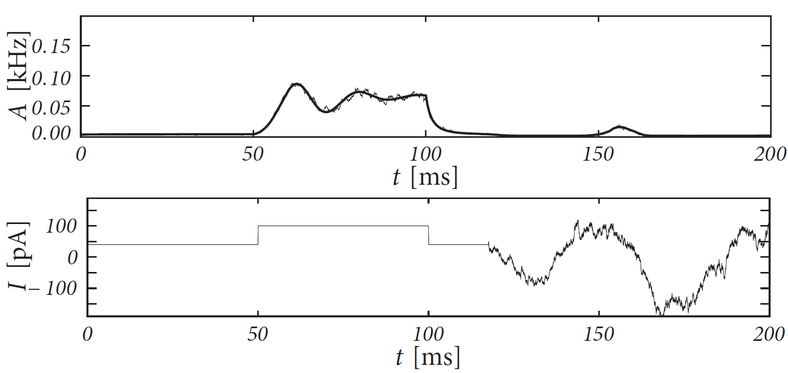
Week 15-part 2: Integral equation – example: LIF
population of
leaky integrate-and-fire
neurons w. escape noise
simulation
input
exact for large population
N→ infinity
Image: Gerstner et al., Neuronal Dynamics, Cambridge Univ. Press

Slide 25
Biological Modeling of Neural Networks:
Week 15 – Integral Equation for population dynamics
15.1 Populations of Neurons
- review: homogeneous population
- review: parameters of single neurons
15.2 Integral equation
- aim: population activity
- renewal assumption
15.3 Populations with Adaptation
- Quasi-renewal theory
15.4. Coupled populations
- self-coupling
- coupling to other populations
Week 15 – Population Dynamics:
The Integral –Equation Approach
Wulfram Gerstner
EPFL, Lausanne, Switzerland

Slide 26
Week 15-part 3: Neurons with adapation
Real neurons show adapation on multipe time scales
Single neurons
- model exists
- parameters extracted from data
- works well for step current
- works well for time-dep. current
I(t)
Population of adapting Neurons?
Population equation for A(t)
- existing modes
- integral equation

Slide 27
Week 15-part 3: population equation for A(t) ?
t
I(t)
?
h(t)
potential
population
activity
Wilson-Cowan
A(t)
A(t)
LNP
A(t)
current
Benda-Herz
A(t)

Slide 28
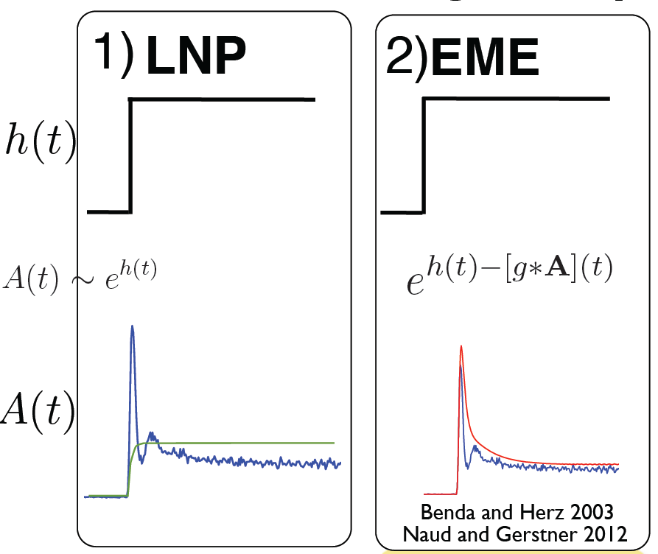
Week 15-part 3: neurons with adaptation – A(t) ?
Rate adapt.
I(t)
simulation
LNP theory
Benda-Herz
optimal filter
(rate adaptation)

Slide 29
Week 15-part 3: population equation for adapting neurons ?
Population of
Adapting Neurons?
I(t)
1) Linear-Nonlinear-Poisson (LNP): fails!
2) Phenomenological rate adaptation: fails!
3) Time-Dependent-Renewal Theory ?
→ Integral equation of previous section
Notes:
1)Geplant fuer 20 min.

Slide 30
Spike Response Model (SRM)
Spike emission
i
Input
I(t)
h(t)
potential

Slide 31
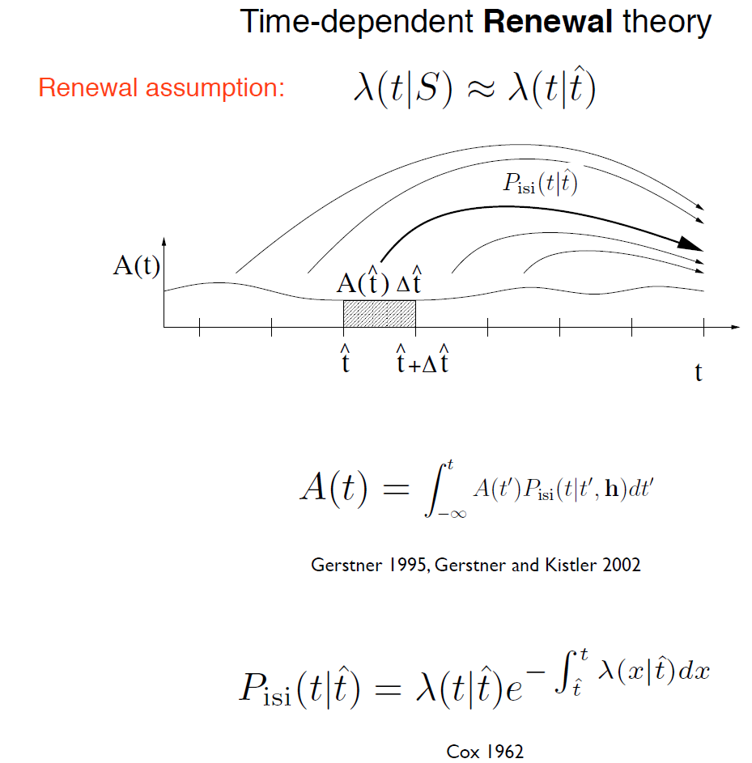
last firing time
Gerstner 1995, 2000; Gerstner&Kistler 2002
See also: Wilson&Cowan 1972
interspike interval distribution

Slide 32
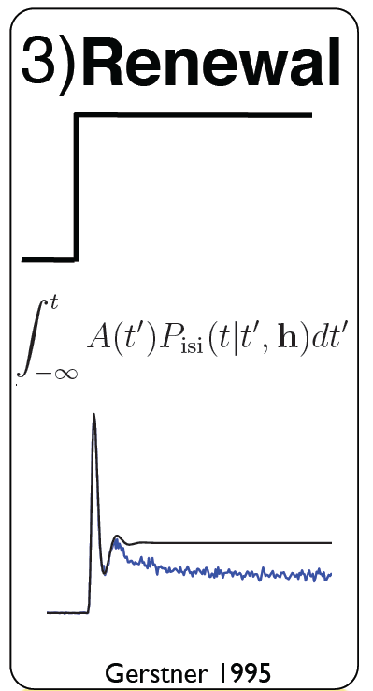
Week 15-part 3: population equation for adapting neurons ?

Slide 33


Week 15-part 3: population equation for adapting neurons ?
Rate adapt.
I
OK in late phase
OK in initial phase

Slide 34
Week 15-part 3: population equation for adapting neurons
Population of
Adapting Neurons
I(t)
1) Linear-Nonlinear-Poisson (LNP): fails!
2) Phenomenological rate adaptation: fails!
3) Time-Dependent-Renewal Theory: fails!
4) Quasi-Renewal Theory!!!
Notes:
1)Geplant fuer 20 min.

Slide 35
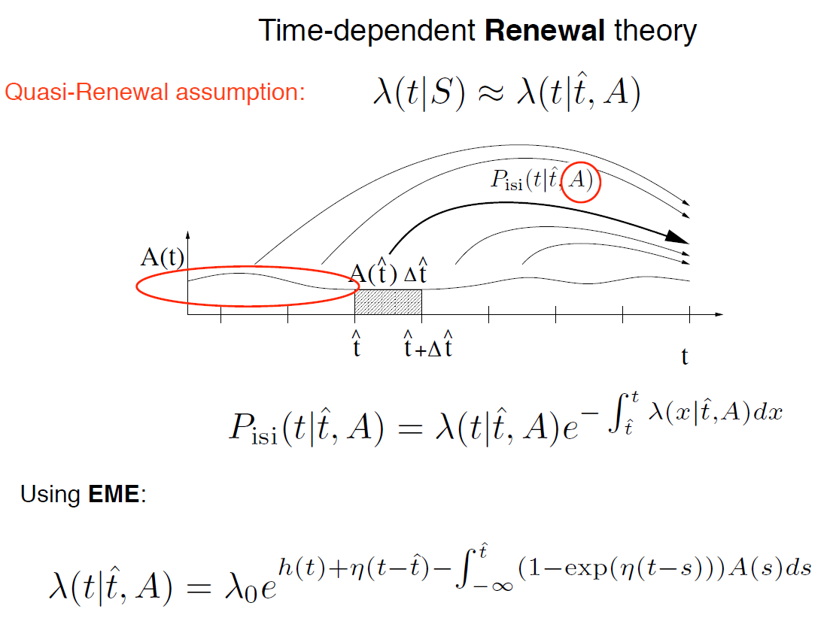
Week 15-part 3: Quasi-renewal theory
and h(t)
Expand the moment generating functional
Blackboard!
g(t-s)

Slide 36
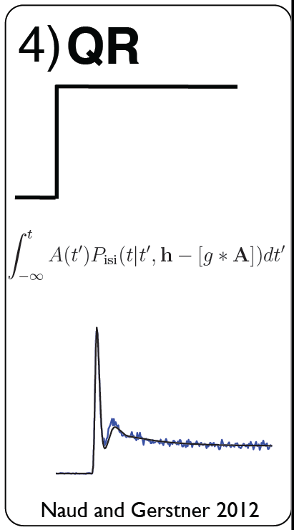

Rate adapt.
Quasi-Renewal
RA
I
OK in initial
AND late phase

Slide 37
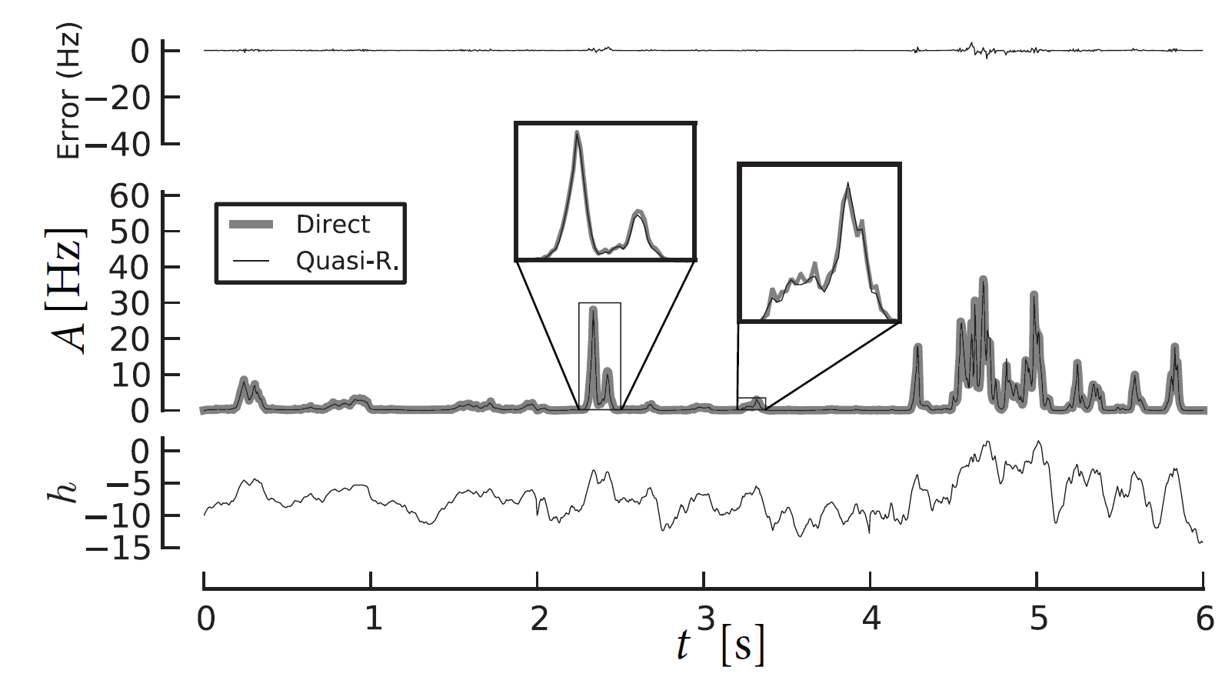
Week 15-part 3: Quasi-renewal theory
Image:
Gerstner et al.,
Neuronal Dynamics,
Cambridge Univ. Press
PSTH or
population activity A(t)
predicted by
quasi-renewal theory

Slide 38
Week 15-part 3: population equation for adapting neurons
Population of
Adapting Neurons?
I(t)
1) Linear-Nonlinear-Poisson (LNP): fails!
2) Phenomenological rate adaptation: fails!
3) Time-Dependent-Renewal Theory: fails!
4) Quasi-Renewal Theory: works!!!!
Notes:
1)Geplant fuer 20 min.

Slide 39
Biological Modeling of Neural Networks:
Week 15 – Integral Equation for population dynamics
15.1 Populations of Neurons
- review: homogeneous population
- review: parameters of single neurons
15.2 Integral equation
- aim: population activity
- renewal assumption
15.3 Populations with Adaptation
- Quasi-renewal theory
15.4. Coupled populations
- self-coupling
- coupling to other populations
Week 15 – Population Dynamics:
The Integral –Equation Approach
Wulfram Gerstner
EPFL, Lausanne, Switzerland

Slide 40
Week 15-part 4: population with self-coupling
Same theory works
- Include the self-coupling in h(t)
J0
Potential (SRM/GLM) of one neuron
h(t)
Notes:
1)Geplant fuer 20 min.

Slide 41
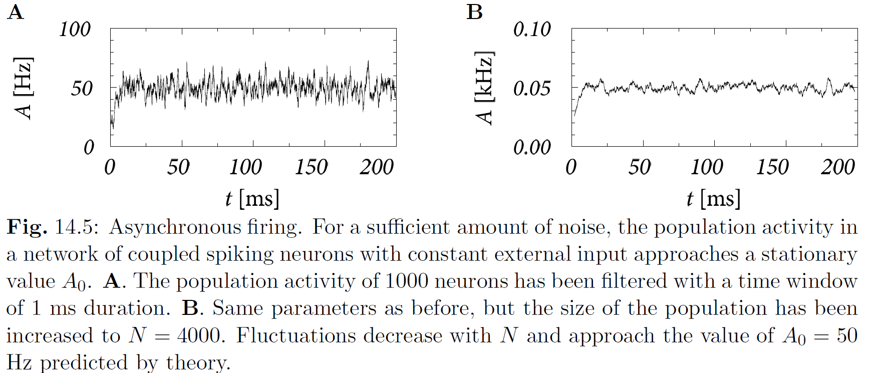
Week 15-part 4: population with self-coupling
Image: Gerstner et al.,
Neuronal Dynamics, Cambridge Univ. Press
Notes:
1)Geplant fuer 20 min.

Slide 42
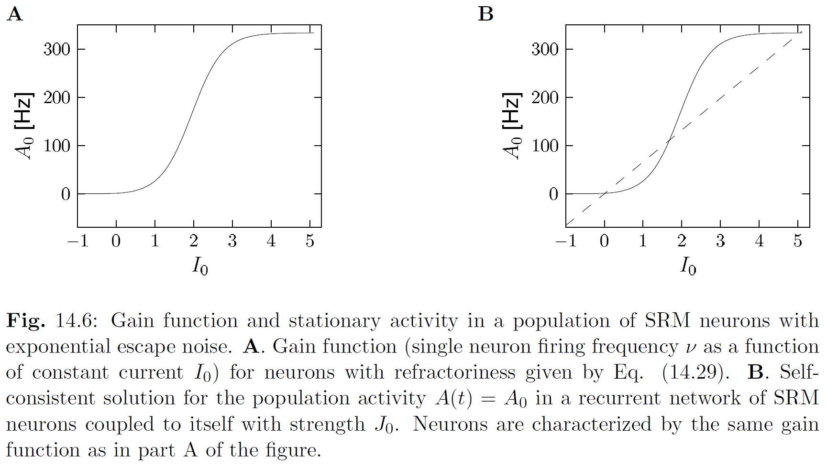
Week 15-part 4: population with self-coupling
J0
Image: Gerstner et al.,
Neuronal Dynamics, Cambridge Univ. Press
Notes:
1)Geplant fuer 20 min.

Slide 43
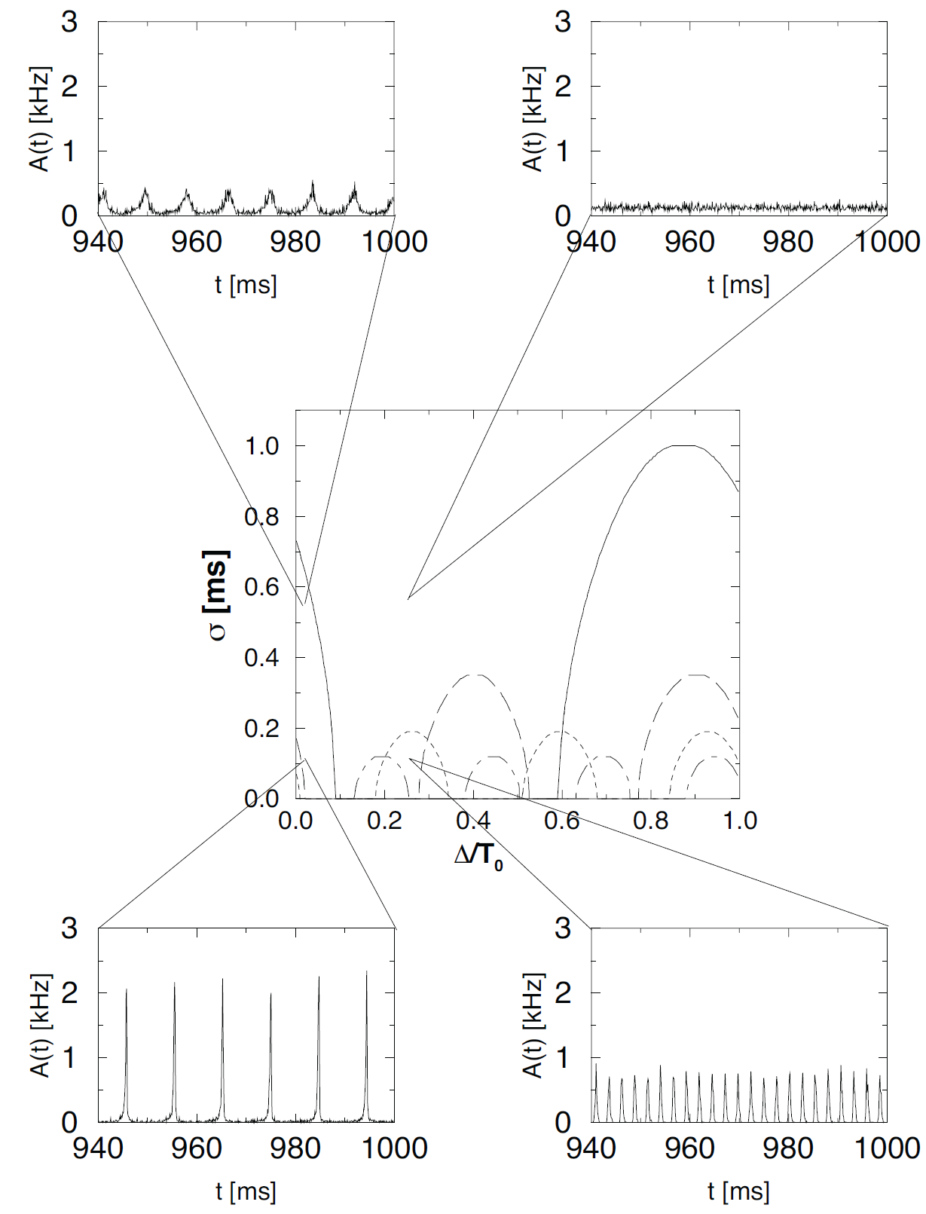
Week 15-part 4: population with self-coupling
instabilities
and oscillations
stable asynchronous state
Image:
Gerstner et al.,
Neuronal Dynamics,
Cambridge Univ. Press
noise level
delay
Notes:
1)Geplant fuer 20 min.

Slide 44
Week 15-part 4: multipe coupled populations
J22
J21
Same theory works
- Include the cross-coupling in h(t)
J11
J12
Potential (SRM/GLM) of one neuron in population n
hn(t)
Notes:
1)Geplant fuer 20 min.

Slide 45
Week 15-part 1: Summary and aims
We can extract parameters for SINGLE neuron
(see NEURONAL DYNAMICS, Chs. 8-11)
Different neuron types have different parameters
→ Model Dynamics in one (homogeneous) population
Today, parts 15.2 and 15.3!
→ Couple different populations
Today, parts 15.4!
Sensory input
Eventually: Understand Coding and Brain dynamics

Slide 46
The end
Reading: Chapter 14 of
NEURONAL DYNAMICS,
Gerstner et al., Cambridge Univ. Press (2014)

